Slide 1


Easy Student Portal & Teachers Info.
Obaydullah Khan – 201002093
Alip Ekram Prince - 201002116

Slide 2
Outlines
Overview
Why This Project
Project Details
Teacher Information
Short Name List
Search by Short Name
Education
Experience
Publications
Research
Student Portal
Billing Status
Result
Profile
Login / Logout
Conclution

Slide 3
Overview & Why This Project
Project Brief
Simplicity
Fast Working
Easy Command Line Work
Secure
Real Time Output

Slide 4
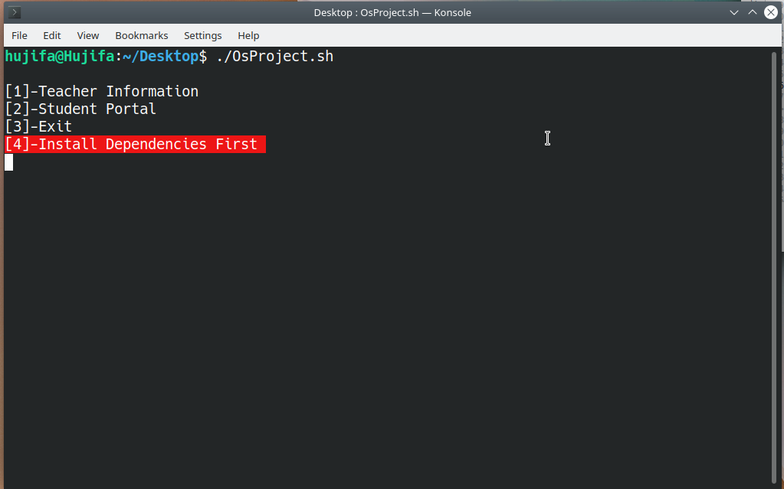
Project Details
Main page {Teacher Info, Student Portal}
If No Dependencies Install Dependencies

Slide 5
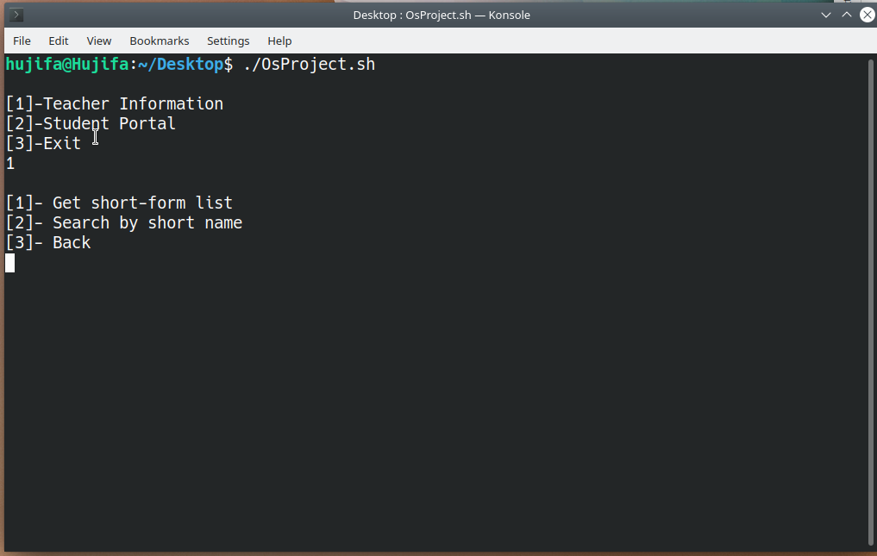
Teacher Information

Slide 6
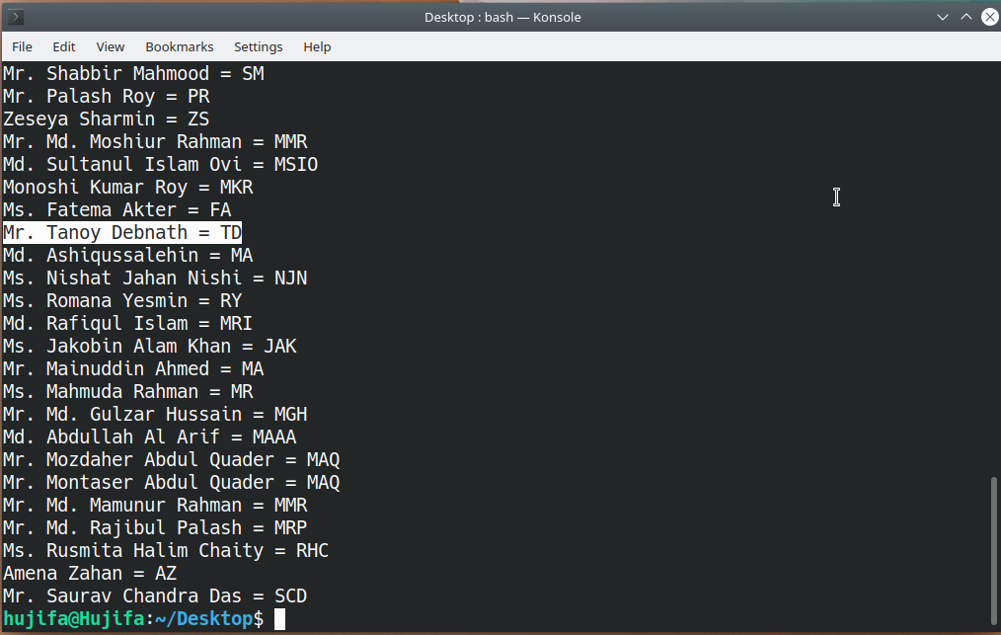
Teachers List

Slide 7
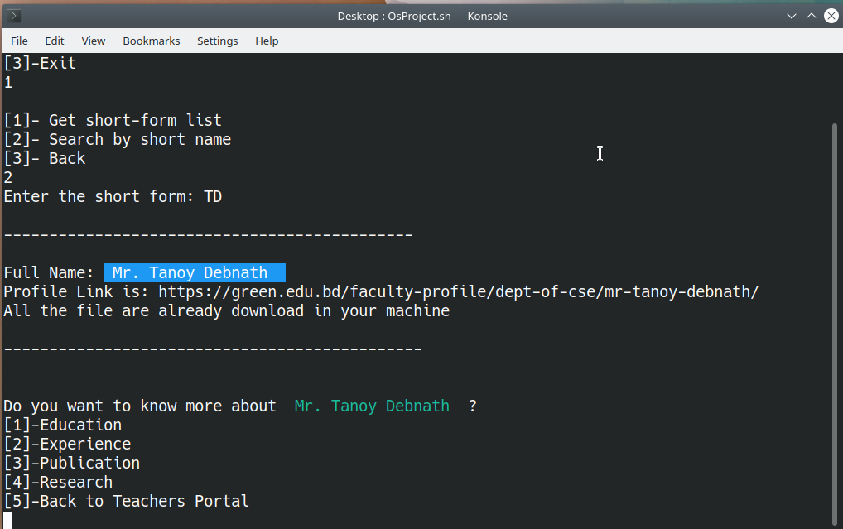
Search by Short Name

Slide 8
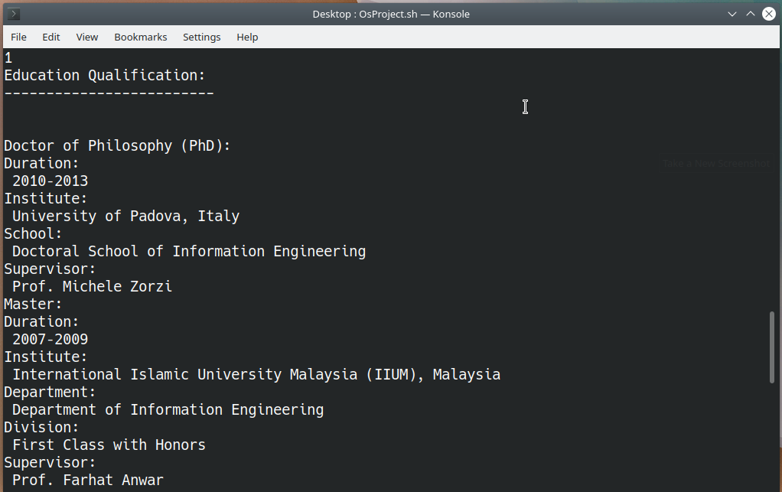
Education Qualification

Slide 9
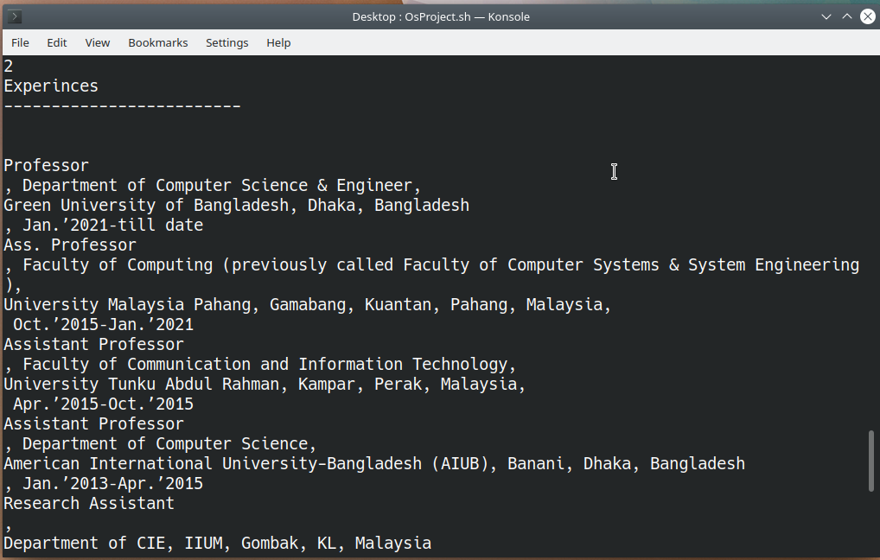
Experiences

Slide 10
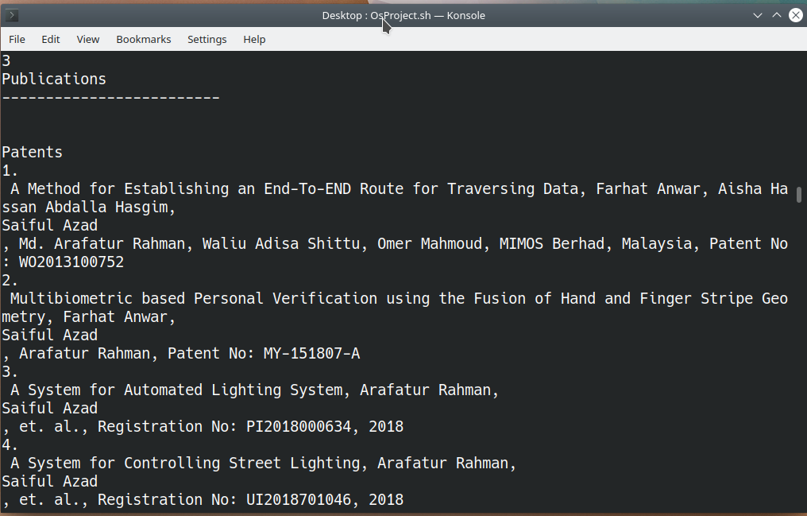
Publications

Slide 11
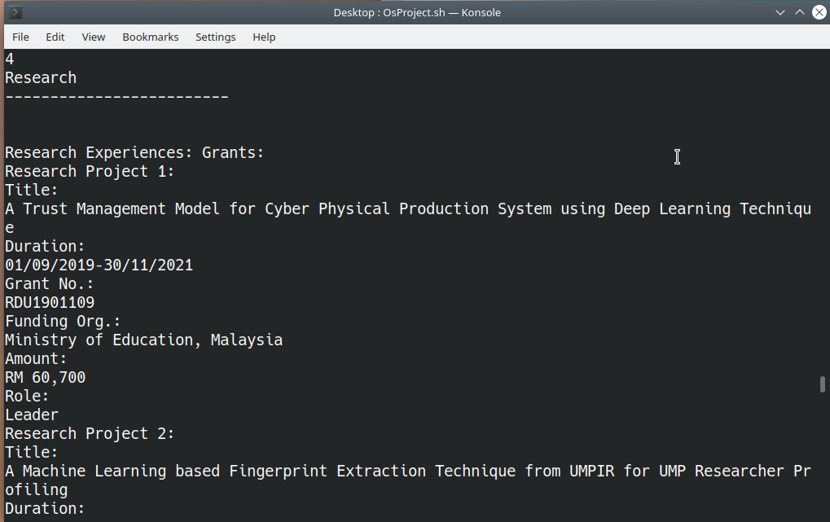
Research

Slide 12
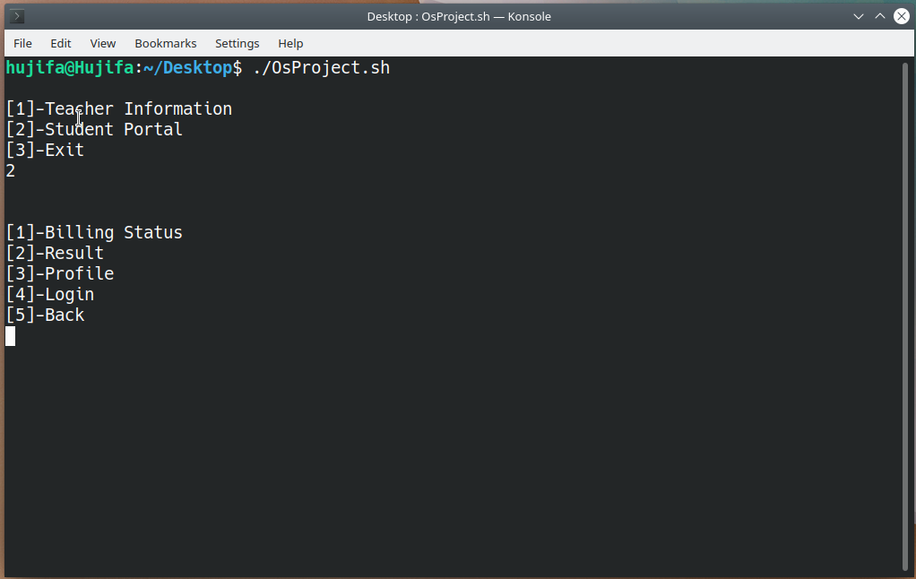
Students Portal

Slide 13
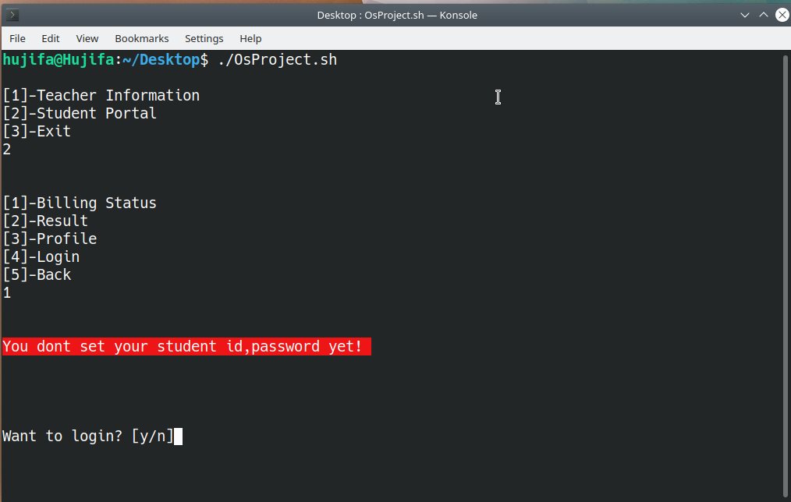
LogIn

Slide 14
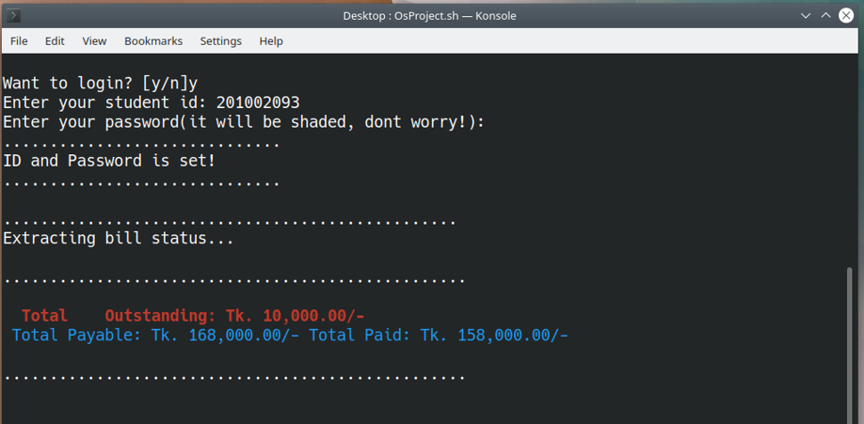
Billing

Slide 15
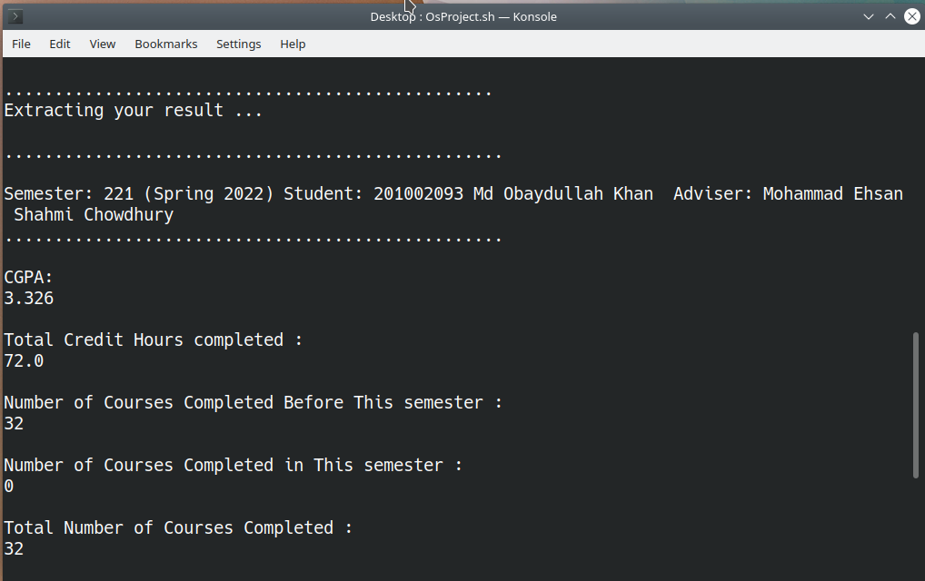
Result

Slide 16
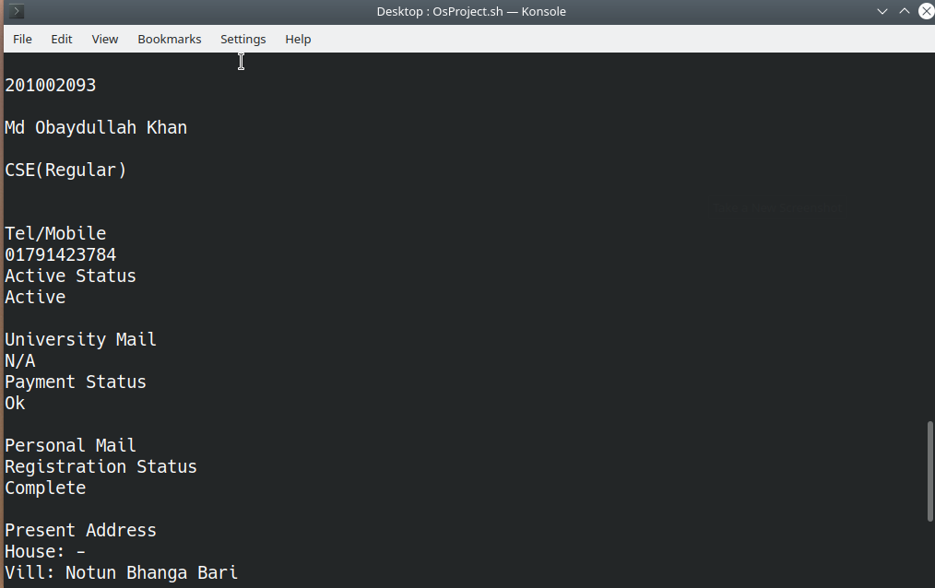
Profile

Slide 17
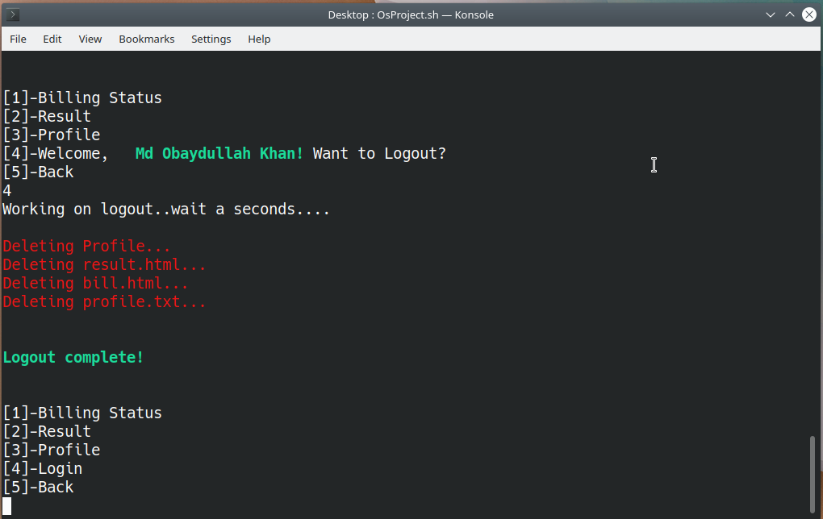
Logout

Slide 18

Conclution
Advantage
Disadvantage

Slide 19


